Slide 1
EE316L GROUP-2
L-C Meter Project
By Necmettin Yigit DUBEK & Harun DURMUS

Slide 2
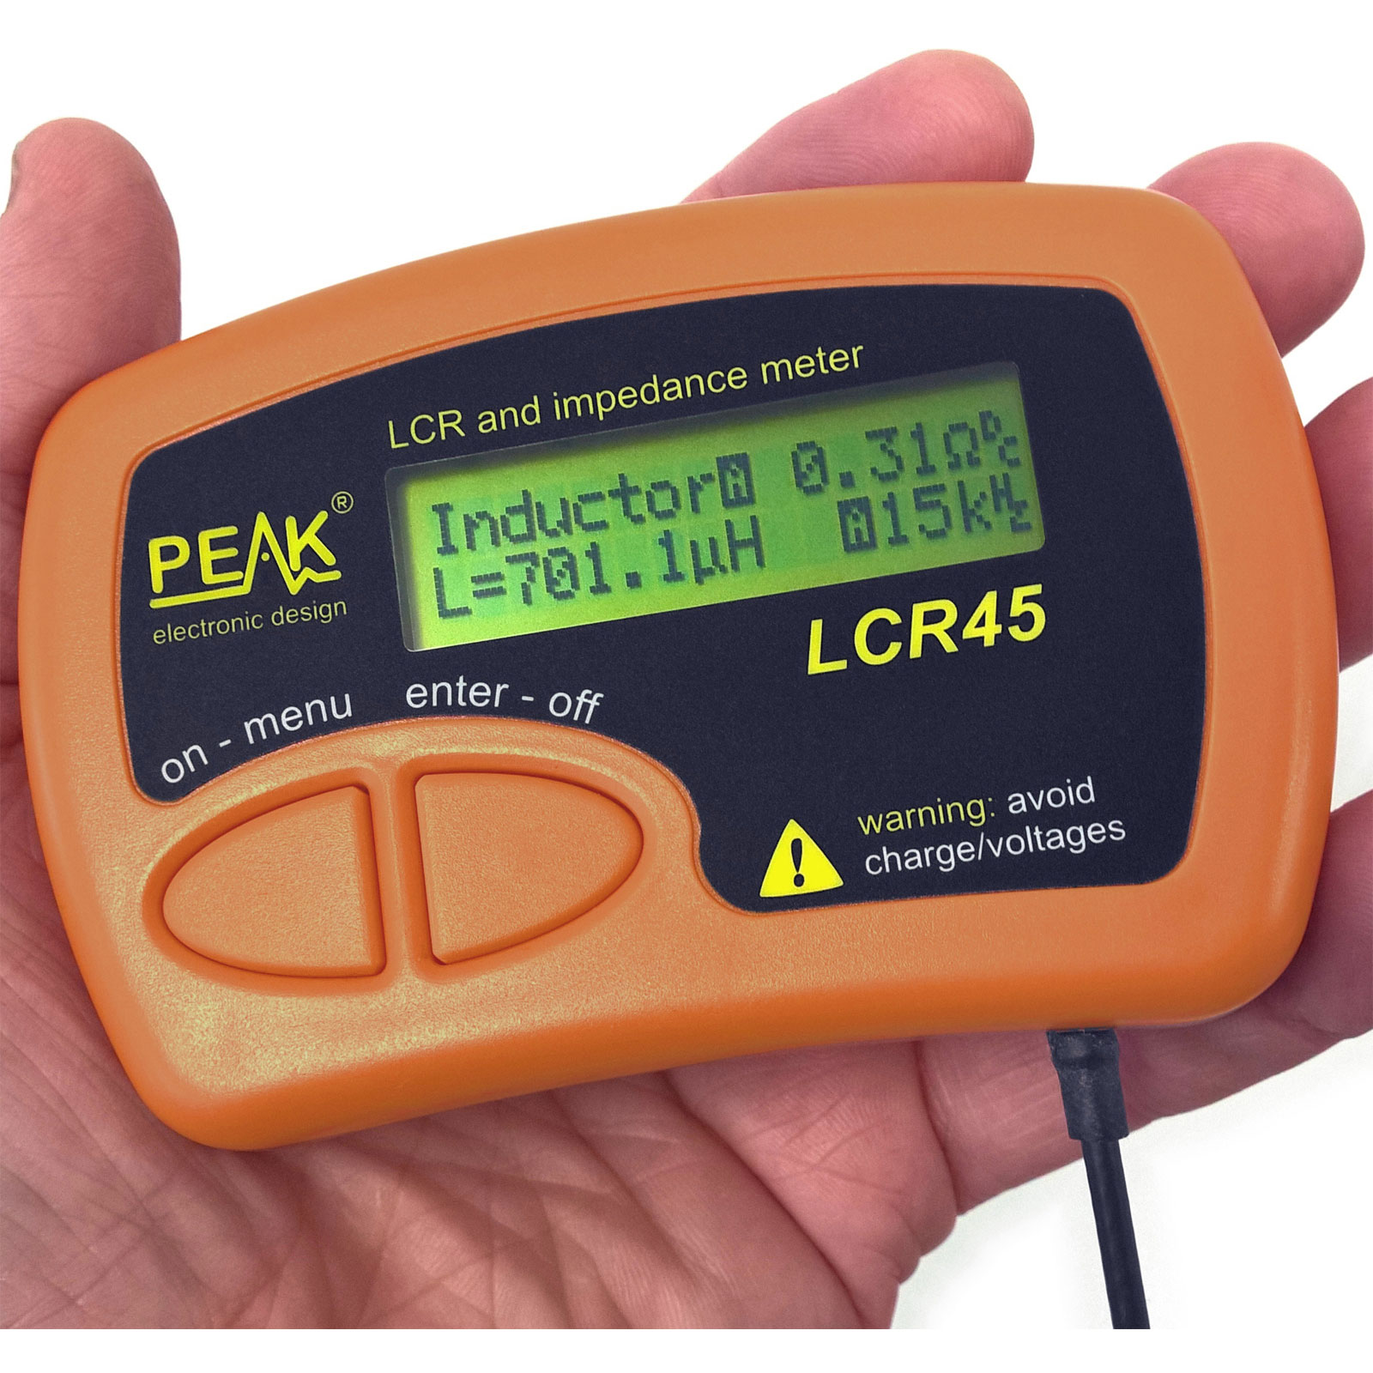
INTRODUCTION
What is the main purpose?
Contents of the procedure

Slide 3
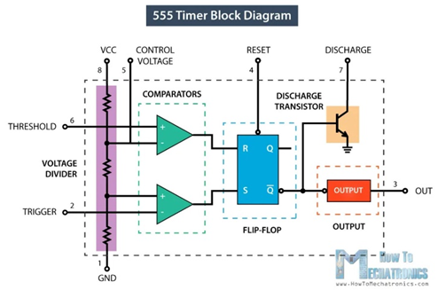
BASIC OSCILLATOR CIRCUITS
555 IC Timer Integrated Circuits and Astable Operation
Circuit Design

Slide 4
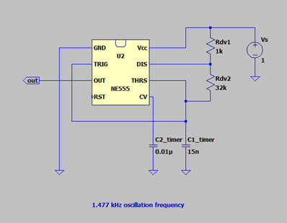
BASIC OSCILLATOR CIRCUITS
555 IC Timer Integrated Circuits and Astable Operation
Circuit Design

Slide 5
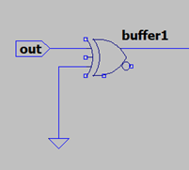
PHASE OR TIME DELAY
Voltage Buffer Operation
LTSpice IV Design

Slide 6
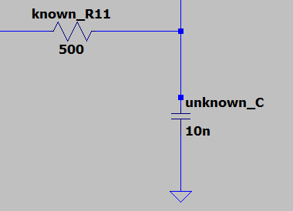
PHASE OR TIME DELAY
Voltage Buffer Operation
LTSpice IV Design

Slide 7
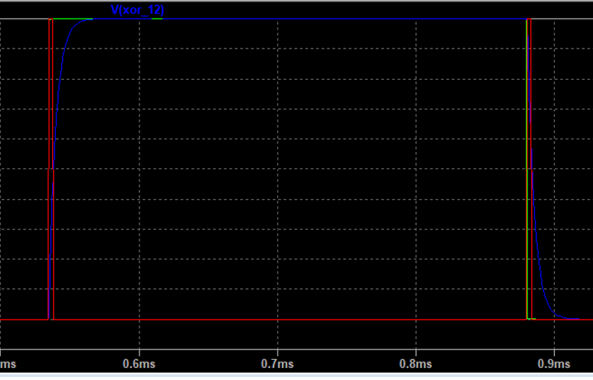
PHASE DETECTION AND COMPARISON
Phase Comparison
Phase Difference Measurement
Accuracy of Measurements
Low-Pass Filtering

Slide 8
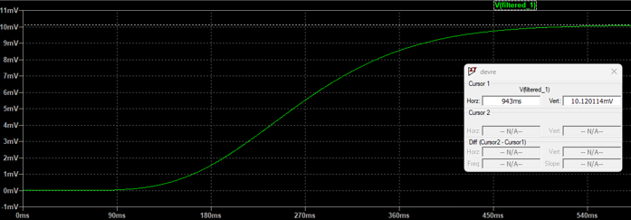
PHASE DETECTION AND COMPARISON
Phase Comparison
Phase Difference Measurement
Accuracy of Measurements
Low-Pass Filtering

Slide 9
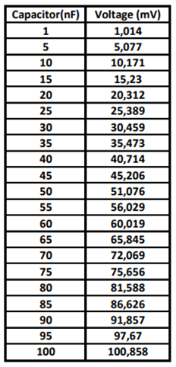
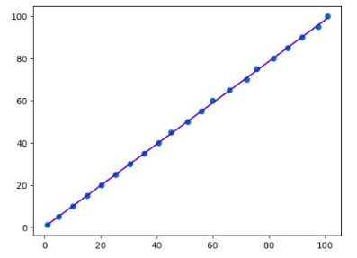
PHASE DETECTION AND COMPARISON
Phase Comparison
Phase Difference Measurement
Accuracy of Measurements
Low-Pass Filtering

Slide 10
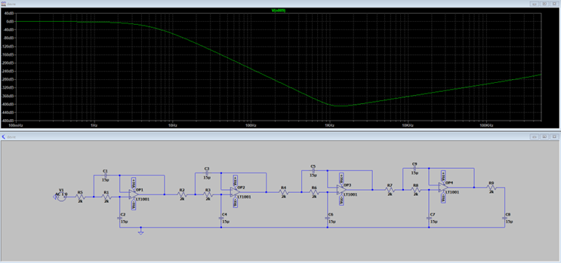
PHASE DETECTION AND COMPARISON
Phase Comparison
Phase Difference Measurement
Accuracy of Measurements
Low-Pass Filtering

Slide 11
LTSPICE IV vs. PROTEUS
Real Life Similarity
Challenging Simulations
LCD Display Libraries
Capability for PCB Layout Design
Project Design in Proteus

Slide 12
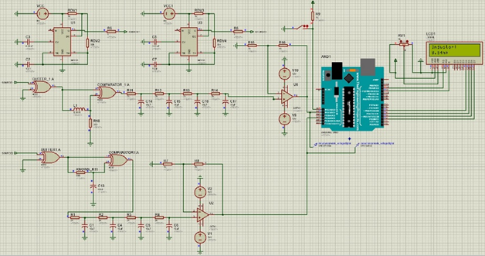
LTSPICE IV vs. PROTEUS
Real Life Similarity
Challenging Simulations
LCD Display Libraries
Capability for PCB Layout Design
Project Design in Proteus

Slide 13
CIRCUIT DESIGN WITH PROTEUS
Reducing Order of Low-Pass Filter
Non-negligible Increase in Measurement Errors
Using Several Linear Equations
Sample Measurements

Slide 14
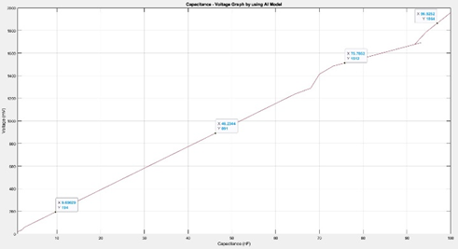
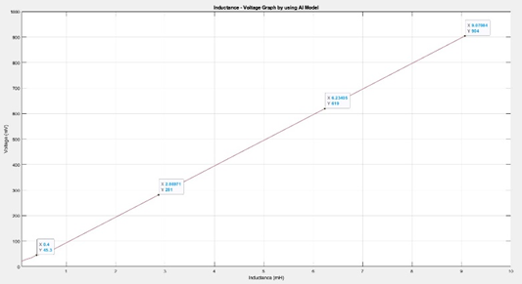
CIRCUIT DESIGN WITH PROTEUS
Reducing Order of Low-Pass Filter
Non-negligible Increase in Measurement Errors
Using Several Linear Equations
Sample Measurements

Slide 15
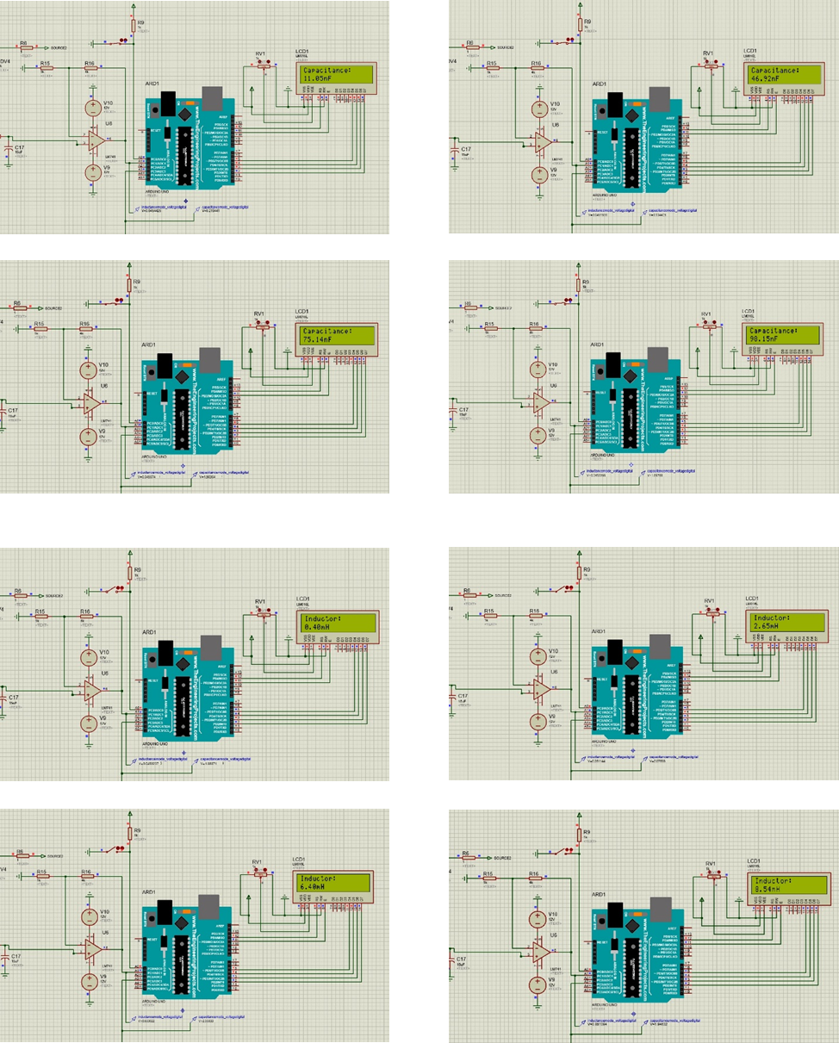
SAMPLE MEASUREMENTS

Slide 16
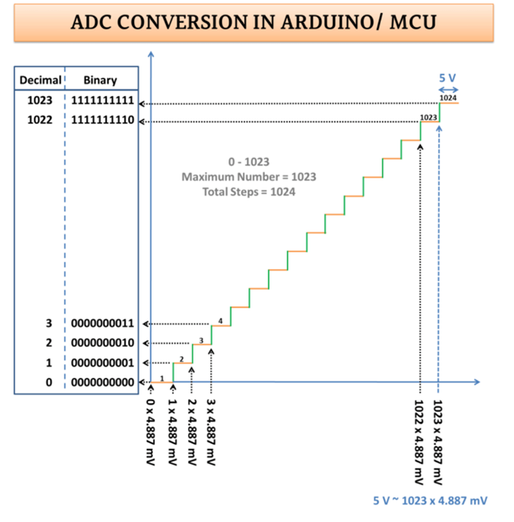
ANALOG TO DIGITAL CONVERTERS
Relationship Between Sensivity and Bit Numbers

Slide 17
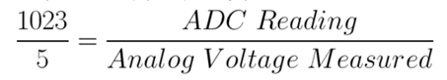
CONVERTING BINARY NUMBERS TO DECIMAL
Processing mV Values
Defining If-Else Conditions
Using LCD Library Functions

Slide 18
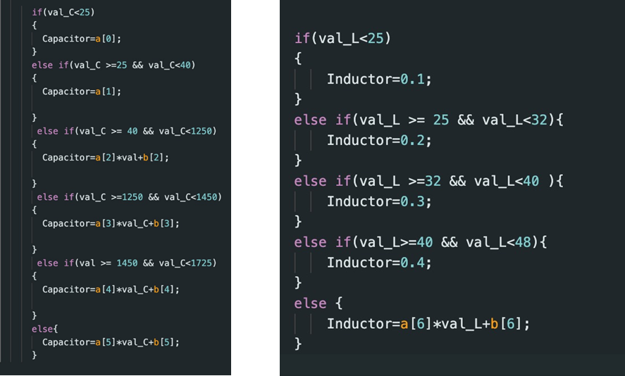
CONVERTING BINARY NUMBERS TO DECIMAL
Processing mV Values
Defining If-Else Conditions
Using LCD Library Functions

Slide 19
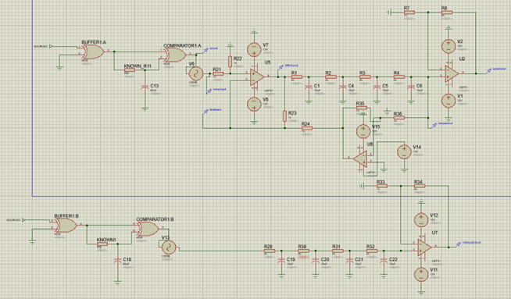
FEEDBACK EXTENSION FOR NOISY MEASUREMENT CONDITIONS
Feedback Design
Case: Sinusoidal Noise

Slide 20
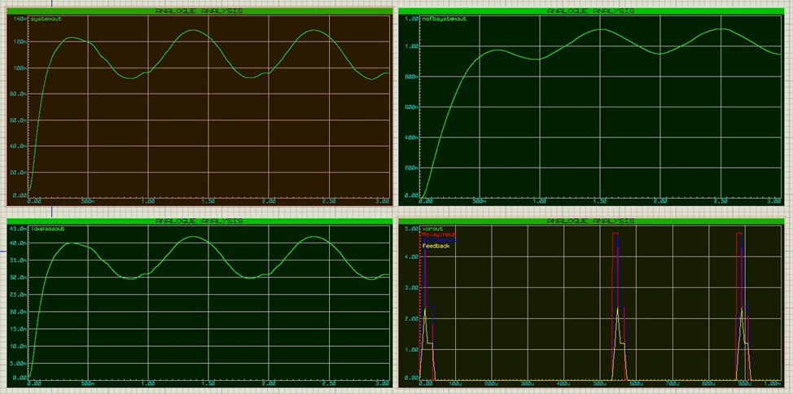
FEEDBACK EXTENSION FOR NOISY MEASUREMENT CONDITIONS
Feedback Design
Case: Sinusoidal Noise

Slide 21
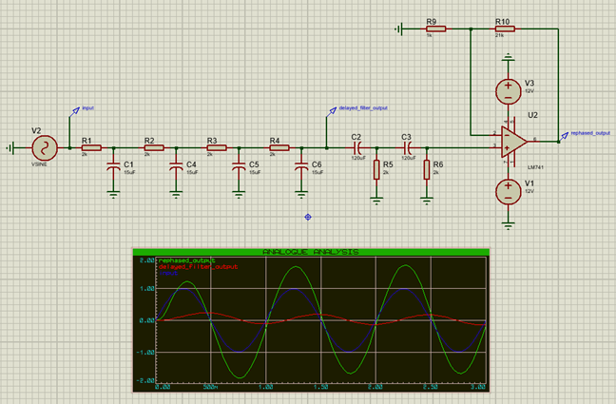
FEEDBACK EXTENSION FOR NOISY MEASUREMENT CONDITIONS
Feedback Design
Case: Sinusoidal Noise

Slide 22
CONCLUSION
Project Objective: Accurate L-C Meter Circuit
(2% Error Rate)
Challenges and Modifications
Feedback Extension Considerations
Achieving Objective
Reliability and Effectiveness

Slide 23
THANK YOU FOR LISTENING...

